Slide 1
Personalized Travel Itinerary Generator
Audrey Richards

Slide 2
Introduction
Generator uses Artificial Intelligence to provide personal travel recommendations
Takes in user inputs: budget and trip type(adventurous, relaxed, or cultural)
Uses a travel_data.csv file with details like cost, ratings, restaurants, accommodations, and activities
Uses K-Nearest Neighbors algorithm to get personalized results
Aims to simplify travel planning by using artificial intelligence to match user preferences with relevant destinations

Slide 3
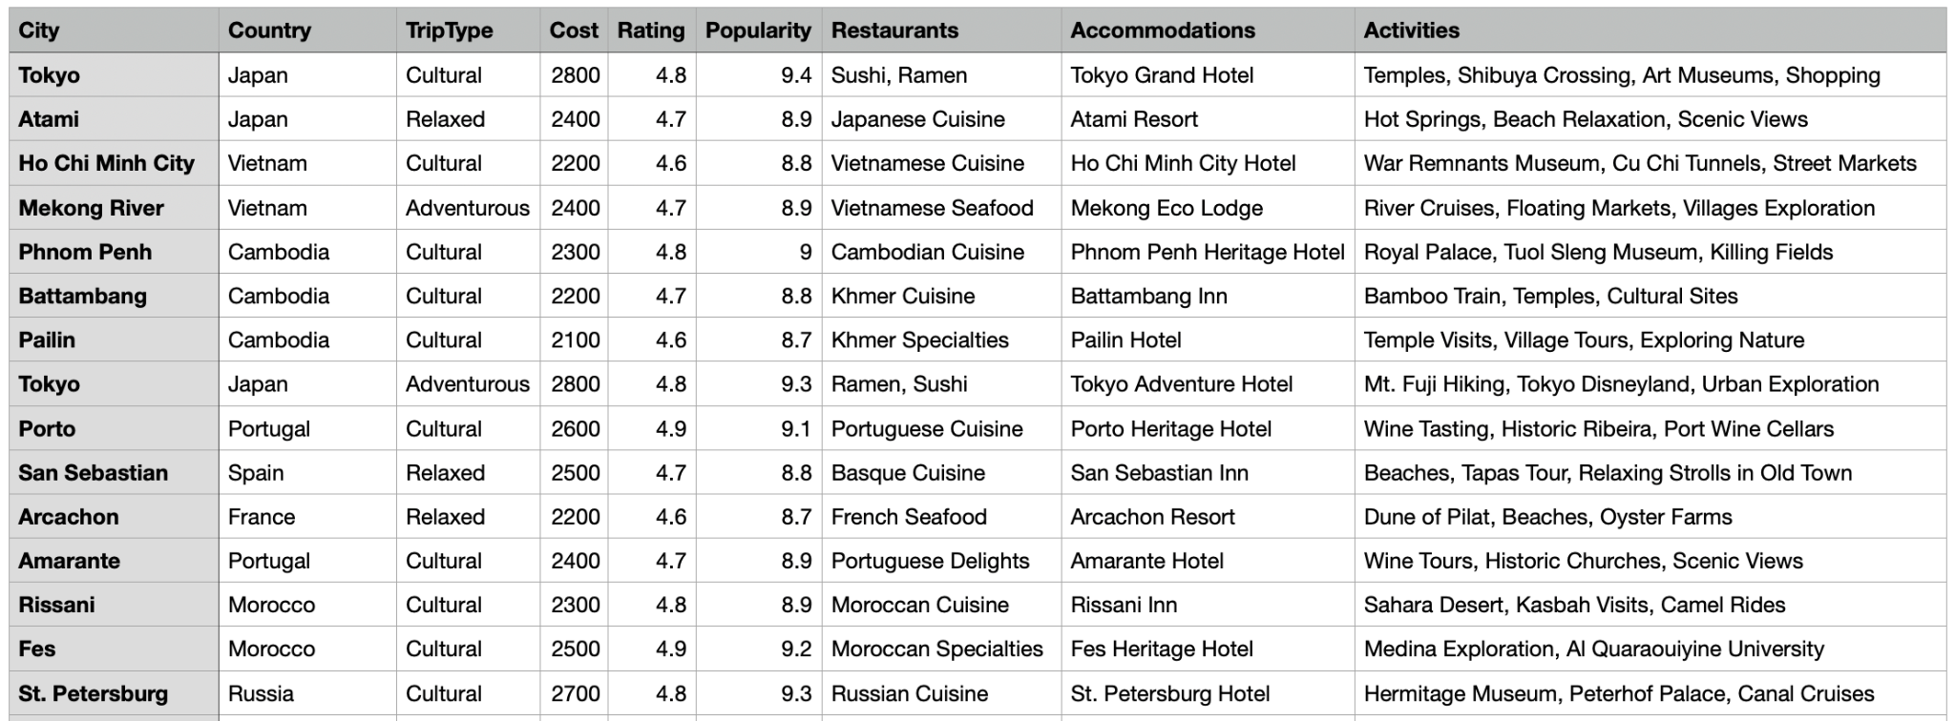
travel_data.csv

Slide 4
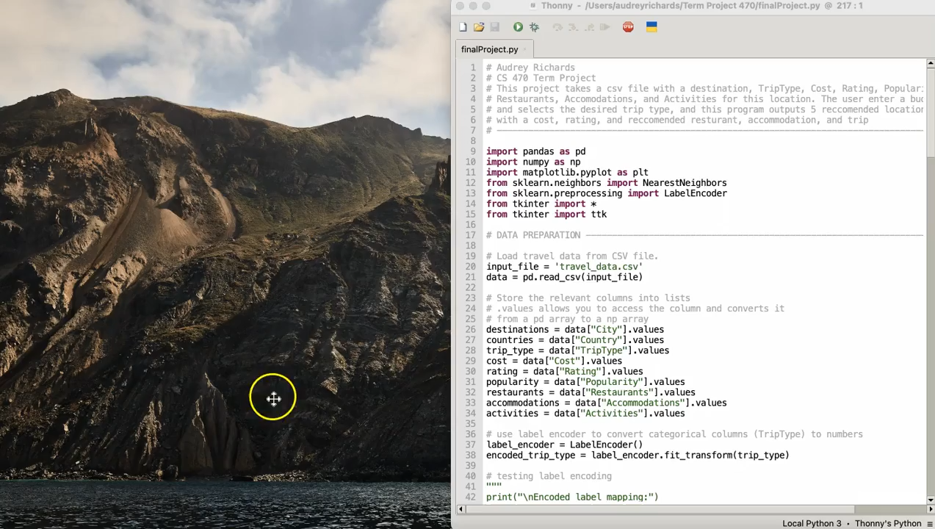
System Demonstration

Slide 5
Step-by-step breakdown of program - data preparation
Load data
Preprocess Categorical Data
LabelEncoder: got technique from traffic_prediction.py(lesson 10b)
Combine Features - researched
>>>a = np.array((1,2,3))
>>>b = np.array((2,3,4))
>>>np.column_stack((a,b))
array([[1, 2],
[2, 3],
[3, 4]])
features = np.column_stack(cost, rating, popularity, encoded_trip_type)

Slide 6
Step-by-step breakdown of program - recommendation system
Obtain user’s input from GUI - .get()
Filter Data
Match the user’s trip type
Create a feature matrix with relevant data for K-Nearest Neighbor
K-Nearest Neighbor Algorithm
Got technique from k_nearest_neighbor.py from lesson 10b clustering
Retrieve and display 5 recommended destinations
Researched how to implement listbox with tkinter
Accuracy calculation
Got technique from gmm_classifier_fixed.py from lesson 11
Scatterplot
Matplotlib - mainly from k_nearest_neighbor.py
Researched a few minor details regarding the visual

Slide 7
Step-by-step breakdown of program - GUI Interface
Create the window
Using Tkinter
Researched and learned how to use tkinter
User Interaction
Allowing the button to work
Display Results
Recommendations appear in listbox
Launch GUI
Window.mainloop()

Slide 8
Thank you!

